Slide 1
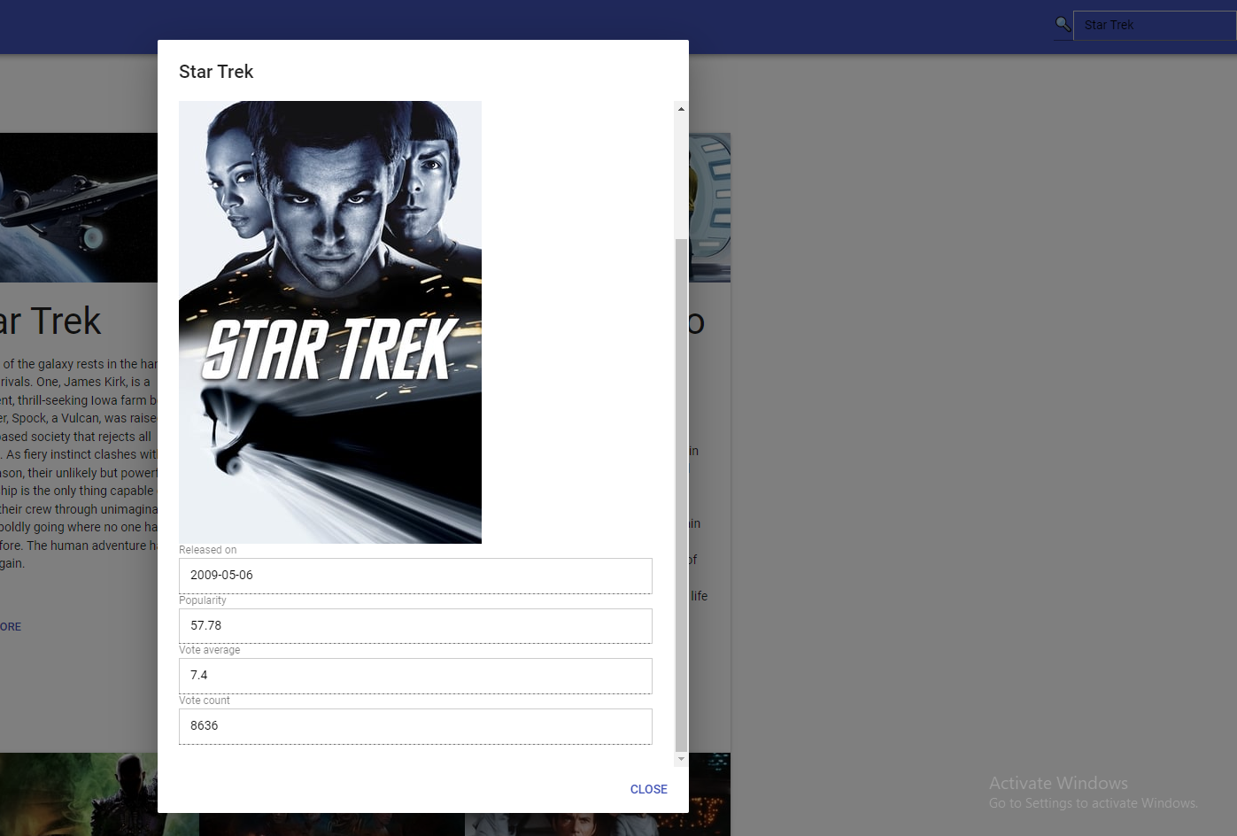

1.No bugs were found when initializing the page and searching for the movie Star Trak , all requirements were found
2. An bug occurred while trying to return to the main page. After reloading the page it worked fine.

